Slide 1
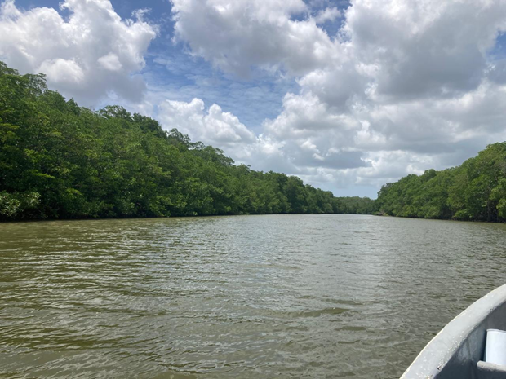

DEVELOPING A NEW STRATEGY OR PROTOCOL ON THE MANAGEMENT OF FRESHWATER RESOURCES WITHIN THE FRAMEWORK OF THE CARTAGENA CONVENTION
Seventh Meeting of the Scientific and Technical Advisory Committee of the Protocol Concerning Pollution from Land-Based Sources and Activities (7th LBS STAC)
Maurice Narcis, PhD
Institute of Marine Affairs
24th July, 2025

Slide 2
Background
Activity - Review, Analysis and Report for developing a new Strategy or Protocol on the management of freshwater resources within the framework of the Cartagena Convention with a focus on Source to Sea and Integrated Watershed Management.
  Design and send questionnaire to the English-speaking countries.
  Update of work done by J. Eugenio Barrios O. on “Outline of Technical Paper on the incorporation of freshwater issues into the LBS Protocol”
  Review of work in other countries on management of freshwater resources including the EU Waters Framework Directive.
  Sub regional report (English-speaking countries) with the information about the national management of freshwater resources with a focus on Source to Sea and Integrated Watershed Management (in English).
  Develop short integrated report in English and Spanish including recommendations for the STAC, which is based on the separate sub regional reports by RAC-IMA and RAC-CIMAB.

Slide 3
Past Work
“Integrated Water Resources Management Framework to Support the Implementation of the Cartagena Convention.” – Barrios, 2021.
  Outlined an IWRM Framework to support implementation of the Cartagena Convention.
  Integration in to the Sustainable Development Goal 6 framework
“Action Framework for Integrated Water Resources Management for the Caribbean Community Region.” Consultancy to Develop a Regional Action Framework for Integrated Water Resources Management for the Caribbean Community Region.” –GWP-C, 2024.
  Provided the current status of IWRM and challenges faced regionally.
  Developed an IWRM Action Framework for the CARICOM Region

Slide 4
Integrated Water Resources Management (IWRM)
Cited as one of the best practices for water resources management worldwide, as it promotes the coordinated development and management of land, water, and related resources to maximize economic and social well-being in a manner that is equitable and does not compromise sustainability.

Slide 5
IWRM Overview
Dublin Statement outlined the action required to reverse the existing trends of overconsumption, pollution, and rising threats from drought and floods.
Guiding Principles
  Fresh water is a finite and vulnerable resource, essential to sustain life, development and the environment
  Water development and management should be based on a participatory approach, involving users, planners and policy-makers at all levels
  Women play a central part in the provision, management and safeguarding of water
  Water has an economic value in all its competing uses and should be recognized as an economic good

Slide 6

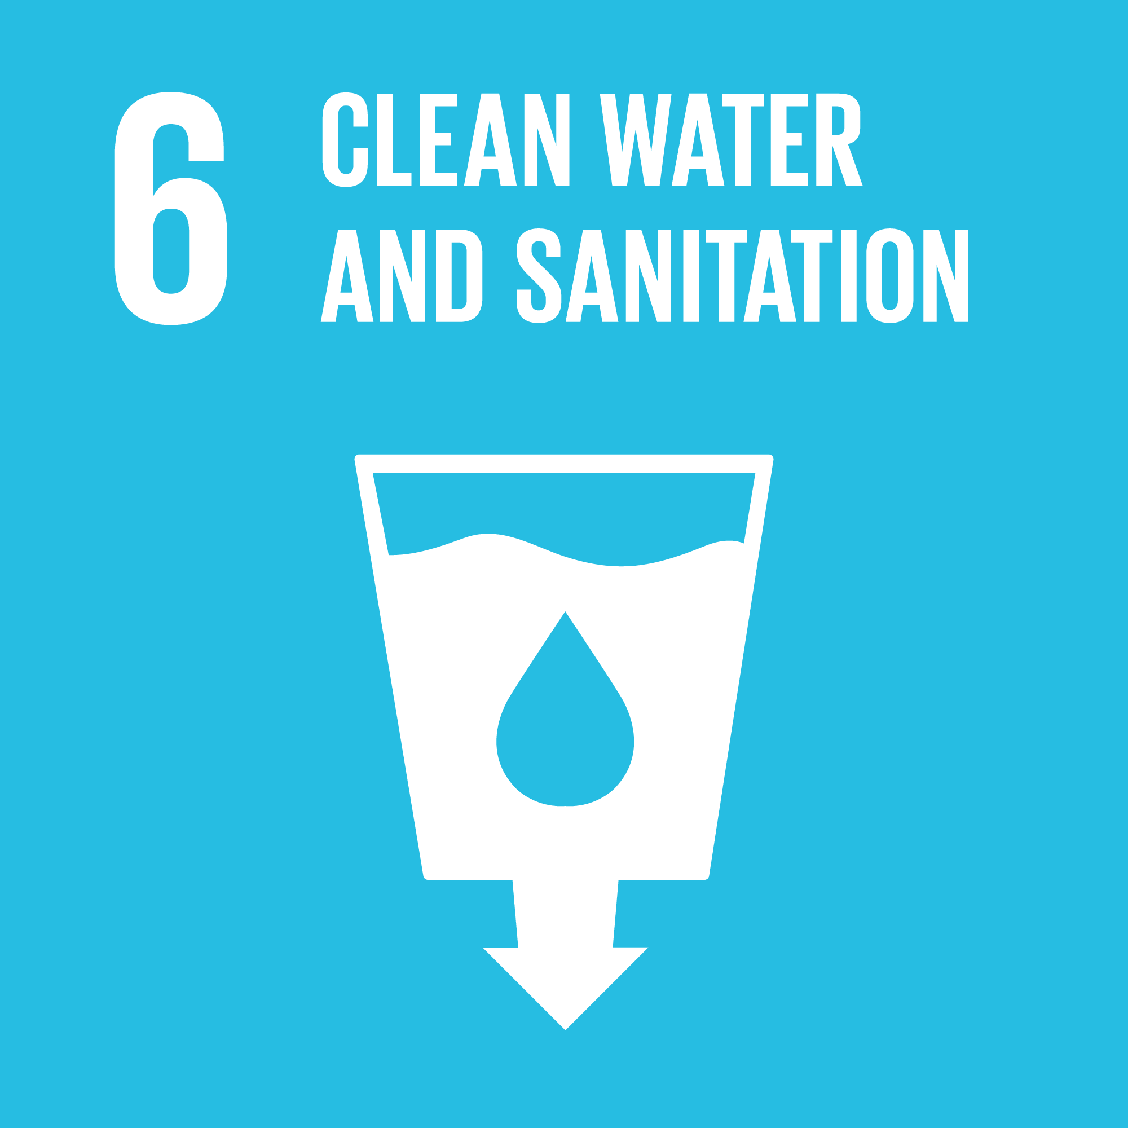
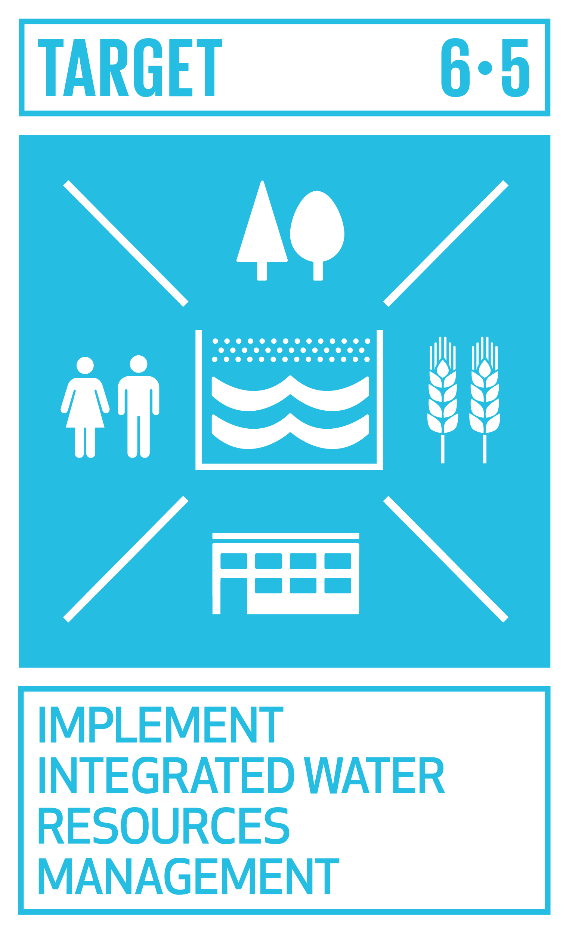
Sustainable Goals SDG 6
SDG 6 - Clean Water and Sanitation
Include the implementation of IWRM (SDG 6.5.1) as a target along with key areas of water resource management such as universal access to drinking water and sanitation, pollution control and water use efficiency among others.
Progress based on four components – Enabling environment, Institutions and participation, Management instruments and Financing

Slide 7
IWRM Challenges
The slow adoption of IWRM in the Wider Caribbean Region (WCR) has been attributed to several challenges including, but not limited to,
Weak or fragmented water resources governance (legislative, political and institutional levels),
Lack of civil society engagement and participation in the water sector,
Data limitations,
Lack of funding,
Shortage of trained technical staff,
Environmental challenges including climate change, poor land use planning, lack of gender mainstreaming, and
Limited monitoring and evaluation.
The development and adoption of IWRM in the region's countries is a priority within the framework of the Cartagena Convention, the only binding regional agreement for the protection of the marine environment of the WCR.

Slide 8
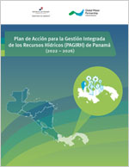
Action Framework for IWRM
An Action Framework for the implementation of IWRM for the Caribbean Community (CARICOM) region has been recently established by the GWP-C.
  The GEF Integrating Water, Land and Ecosystems Management in Caribbean Small Island Developing States (IWEco) regional project
  Development aimed towards enabling a streamlined approach within the CARICOM Member States / Small Island Developing States (SIDS)
Integrated Water Resources Management Plans/ National Policies
  El Salvador, Guatemala, Nicaragua, Panama (GWP-CA)
  Colombia, Cuba, Honduras, Mexico

Slide 9
Regional Challenges
Climate Change and Disaster Risk Reduction
Gender, Youth and the Role of Women
Land use and Pollution
Financing in the Water Sector
Transboundary Water Management
Water Availability
Climate Variability and Change
Overcoming Implementation Deficits Water Efficiency
Non-Revenue Water

Slide 10
REGIONAL ACTION FRAMEWORK FOR IWRM
Vision: A harmonised Integrated Water Resources Management model that ensures water security.
Mission: To develop a Regional IWRM framework that promotes sustainable water governance through creating an enabling environment and building climate and disaster resilience for the sustainable development.
Objective: To strengthen the policy, legislative and institutional mechanisms, and capacity building for Integrated Water Resources Management (IWRM) and ecosystem services management, while increasing climate and disaster resilience.

Slide 11
Strategic Goals
Strategic Goal 1
Improve capacities/frameworks for holistic, multi sectoral and cross cutting disaster risk reduction and climate change adaptation that integrates circular economic principles and gender considerations.
Strategic Goal 2
Encourage coordination among key water stakeholders towards harmonisation, communication, and community empowerment and involvement at the national and regional levels.
Strategic Goal 3
Promote knowledge based participatory approaches that incorporate Traditional Ecological Knowledge (TEK) or Local Ecological Knowledge (LEK) traditional, /nature based solutions, the role of women and Indigenous knowledge towards improved water resources management.

Slide 12
Strategic Goals
Strategic Goal 4:
Guide the development or strengthening of an independent, overarching water resources entity to govern inter agency coordination and oversight at the national level, and cooperation at the regional level.
Strategic Goal 5:
Strategise the introduction of water information systems, with monitoring and evaluation mechanisms to improve data collection, sharing and access at the national and the regional levels.
Strategic Goal 6:
Identify and facilitate the implementation of sustainable financing mechanisms.

Slide 13
Critical Elements for IWRM Implementation
Political Will and Commitment
Essential to the successful implementation of a regional framework on IWRM, noting the anticipated changes in institutional governance mechanisms
Capacity Building
Sourcing skilled personnel is a corequisite for implementing the framework. Formal certification programmes in IWRM should be developed through partnerships with regional tertiary-level institutions, which should complement and strengthen collaborations with new and existing capacity-building agencies
Sustainable Financing
Access to financing to implement IWRM programmes and plans is a primary constraining factor among member countries. Implementing agency to develop a sustainable financing strategy and identify innovative financing mechanisms.

Slide 14
Critical Elements for IWRM Implementation
Data Collection, Analysis, Reporting and Sharing
Requires the responsible authority to develop a harmonised programme for data collection across priority areas in IWRM and the integration into user-friendly, accessible, national and regional information systems.
Governance Mechanisms
Assumption of administrative responsibility for the coordination of regional implementation through the appropriate unit. A major factor in successful implementation is the provision for regional discussion and strategic development
Monitoring and Evaluation
Monitoring and evaluation facilitate the validation of strategic objectives and measurement of progress while contributing to framework feasibility and adaptation to evolving conditions and use.

Slide 15
EU – Water Framework Directive
To establish a system for the protection of inland surface waters, transitional waters, coastal waters and groundwater across its member states.
To preserve and enhance the status of aquatic ecosystems, with certain particulars depending on the water body type.
Promotes sustainable water use by focusing on long-term protection of the available water resources.
The framework also aims towards mitigating against the effects of floods and droughts, the protection of territorial and marine waters and the achievement of the objectives of relevant international agreements.

Slide 16
Water Protection
The WFD focuses on ensuring good qualitative and quantitative health, i.e. on reducing and removing pollution and on ensuring that there is enough water to support wildlife at the same time as human needs
It applies to inland, transitional and coastal surface waters as well as groundwaters.
It ensures an integrated approach to water management including by regulating individual pollutants and setting corresponding regulatory standards.

Slide 17
Water Management
Member States must identify the basin districts located within their territories. Those districts are regrouped in river basin districts where small river basins maybe included with a larger river basin.
Coastal waters are also included and are identified and assigned to the nearest or most appropriate river basin district or districts.
A river basin management plan (RBMP) is established for each river basin district and includes relevant elements for implementing the applicable legislation

Slide 18
Transboundary Management
The WFD treats with transboundary issues between Member states by mandating any river basin that lies in more than one territory will be identified as an international river basin district.
Each member state is responsible for the administrative arrangements which include identifying the authoritative body that will apply the rules of the WFD for the part of the river basin lying within their respective state.
In the instance where a river basin district extends to non-Member state of the EU, the relevant Member state(s) involved must ensure coordination between all parties to meet the objectives of the WFD.

Slide 19
Recommendations emanating from the paper
A new Technical Agreement should be created for IWRM in the region.
The strategic goals identified are harmonised for both English and Spanish-speaking countries in the WCR.
The consolidation of coastal water bodies and the respective rivers/river systems/river basins that drain into them, whereby they form one unit. This is representative of a Source-to-Sea approach
The development of an IWRM Protocol should include an Annex with discharge limits/pollutant loads for all surface water and freshwater sources for effective management of water quality
Transboundary agreements should be established between countries that share a river basin to ensure multisectoral cooperation for the complete management of the collective water resource.

Slide 20
Recommendation to STAC
Contracting Parties request that the LBS COP consider recommending to the Cartagena Convention COP the establishment of a new working group to further investigate the issue of Integrated Water Resource Management in the context of the Cartagena Convention.

Slide 21
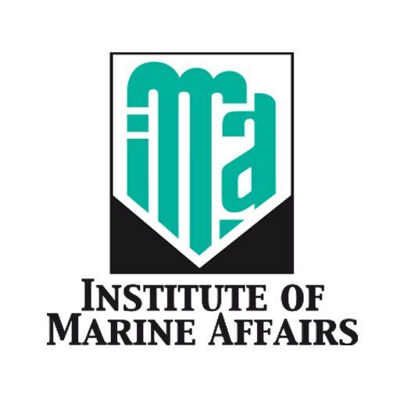
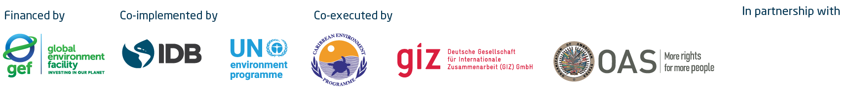
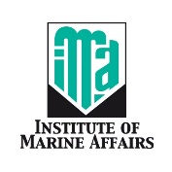
Thank You
Email: mnarcis@ima.gov.tt
http://www.ima.gov.tt

